Slide 1
Assuring quality in education
Policies and approaches to school evaluation in Europe
Isabelle De Coster
18 November 2015 – National conference on Quality Assurance
ssurance-Slovenia
EACEA/Eurydice Education & Youth Policy Analysis

Slide 2
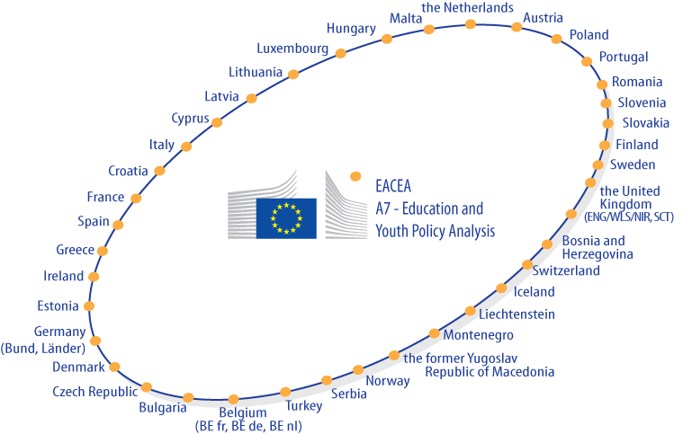
Eurydice Network in 2015
37 COUNTRIES
41 NATIONAL UNITS
(under Ministries’ responsibility)
2

Slide 3
Eurydice: mission statement
To provide those responsible
for education systems and policies in Europe with European-level analyses and information which will assist them in their decision making.
3

Slide 4
The report on school evaluation
Comparative analysis of school evaluation systems
External evaluation
Internal evaluation
National Profiles (32 countries including all MS)
External evaluation
Internal evaluation
Other quality assurance methods
Reforms
Contents
Notes:
Full-time compulsory education.
Public schools (private only in BE, IE, NL, UK)
EU Ms + IS, NO, TR & Fyrom

Slide 5
Why school evaluation
Recommendations of the European Parliament and Council on European cooperation in quality evaluation in school education. OJ C 116, 1.3.2001
Council conclusions ET2020: emphasis on quality in education (Strategic objective 2). OJ C 119, 28.5.2009
Council conclusions on quality assurance supporting education and training. OJ C 183, 14.6.2014
Draft 2015 Joint Report of the Council and the Commission on the implementation of ET2020. 26.8.15

Slide 6
What is school evaluation
Evaluation: systematic and critical analysis of a defined subject
One among other quality assurance approaches in education
Focuses on the school as an entity and unity
Does not place responsibility on individuals but on the overall functioning of the school

Slide 7
External evaluation
Widely used approach (26 countries)
Development over the last ten years
Linked to school autonomy
Evolution of its nature:
From individual staff to school as a whole
From 'checklist' to culture of quality enhancement (legal compliance dimension AND efficiency/efficacy)

Slide 8
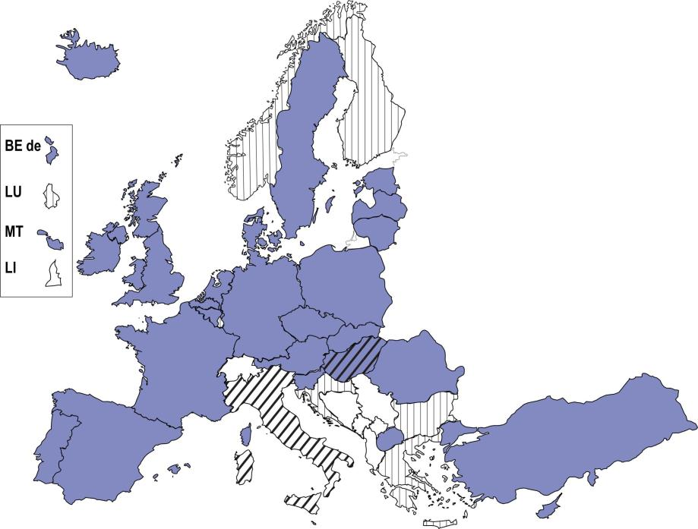
Figure 1.1: Status of the external evaluation of schools according to central/top level regulations, full-time compulsory general education, 2013/14
External evaluation of school is carried out
ISCED 1
CY
External evaluation of school carried out as a piloting phase
No external evaluation of school is carried out

Slide 9
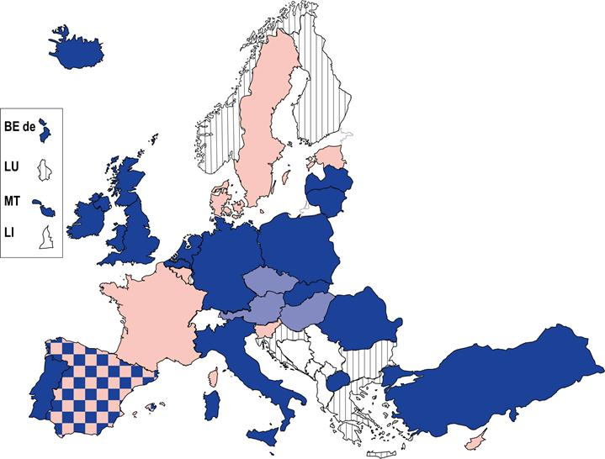
Figure 1.3: Central/top level arrangements for establishing the content and criteria of external school evaluation, full-time compulsory general education, 2013/14
ISCED 1:
CY
Specific framework with parameters and standard
Specific framework with parameters but no standards
List of topics to cover/indicators to consider
No external evaluation of schools/no central regulations
Notes:
Figure 1.1 School evaluation in Europe 2014

Slide 10
School evaluation framework used in Scotland
Nine key areas:
1. Key performances outcomes
2. Impact on learners
3. Impact on staff
4. Impact on the community
5. Delivery of education
6. Policy development and planning
7. Management and support of staff
8. Partnerships and resources
9. Leadership

Slide 11
Each key area is represented with various quality indicators
EX. Key area "Delivery of education"
5.1 The curriculum
5.2 Teaching for effective learning
5.3 Meeting learning needs
5.4 Assessment for learning
5.5 Expectations and pormoting achievment
5.6 Equality and fairness
5.7 Partnerships with learners and parents
5.8 Care, welfare and development
5.9 Improvement through self-evaluation

Slide 12
Each quality indicators corresponds to several themes
EX. Key area "Delivery of education"
Quality indicator "Teaching for effective learning"
The learning climate and teaching approaches
Teacher-pupil interaction including learners’ engagement
Clarity and purposefulness of dialogue
Judgements made in the course of teaching

Slide 13
Level of achievement for 'Delivery of education'
Level 5:
Building on our shared values, we create a stimulating learning climate using skilful and well-paced teaching and learning approaches. Learners’ experiences are well matched to their needs and sustain their motivation and attention. We develop learners’ abilities to be curious and creative and to think critically. Tasks and activities in our classes and home-learning activities are well planned and involve learners as effective contributors, working independently and with others cooperatively in solving problems. We make full and effective use of ICT during teaching and learning.
We share the purposes of lessons with learners. Learners know what they need to do to improve and to become successful. Our explanations and instructions are clear and build on previous learning and real-life experiences. We ensure that learners have opportunities to take responsibility for aspects of their own learning and their relationships with others. Learners enjoy their experiences and make progress in their skills as learners. They are engaged in learning and aware of themselves as learners. We use feedback effectively to promote learning.

Slide 14
Figure 1.4: Procedures for external evaluation, full-time compulsory general education, 2013/14
Analysis of documents
Risk assessment
Visit to the school
Classroom observation
Interviews with
school staff
Involvement of
stakeholders
Final report
Left ISCED1
Right ISCED 2-3

No external school evaluation/ no central regulations on external school evaluation
Source: Eurydice

Slide 15
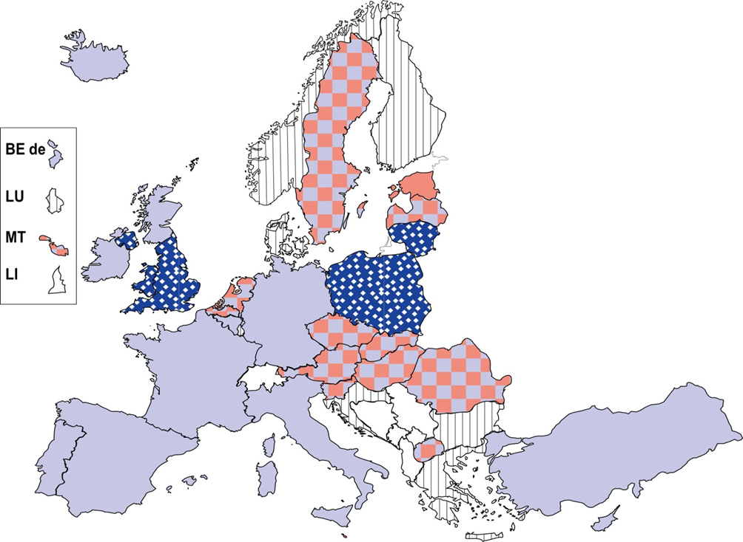
Figure 1.7: Typology of outcomes following the school external evaluation report, full-time compulsory general education, 2013/14
Remedial actions
ISCED 1
FR CY
Disciplinary actions
Profile-raising actions
All three typologies
No external evaluation
Source: Eurydice

Slide 16
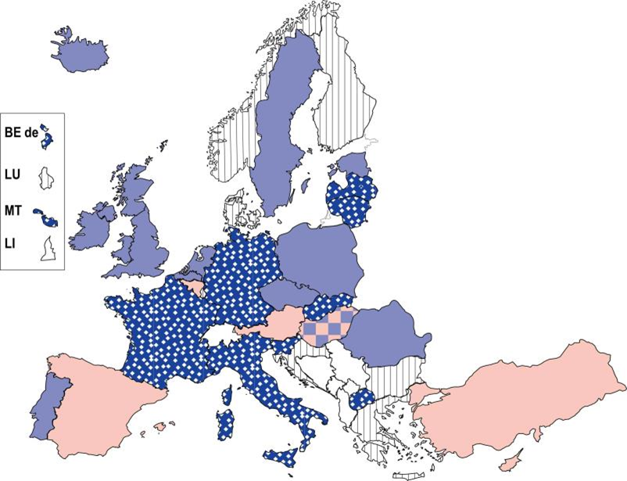
Figure 1.9: Distribution of evaluation reports, 2013/14
Reports are made public
Reports are distributed with restrictions
No distribution of the reports to outside parties
ISCED 1
CY RO
No external school evaluation/ no central regulations on external school evaluation
Source: Eurydice

Slide 17
Internal evaluation
Compulsory in 27 education systems
In most of the others it is recommended
Only in France (ISCED1) and Bulgaria there is no obligation or recommendation at central/top level
Focus varies among countries

Slide 18
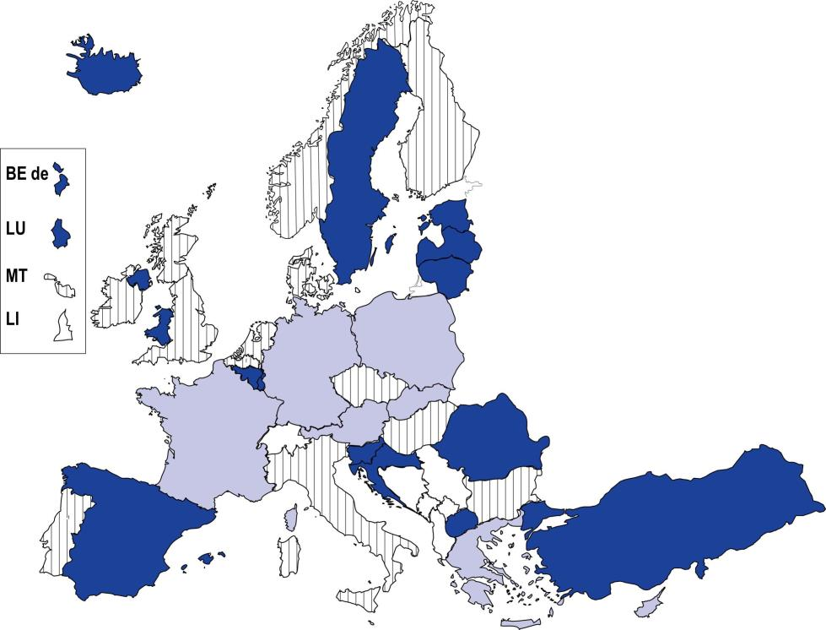
Figure 2.2: Parties involved in internal evaluation of schools according to central/top-level regulations, full-time compulsory general education, 2013/14
ISCED 1
FR CY
School staff
School staff + parents/students/ other school stakeholders
ISCED 2 and 3
LU
No central/top level regulations on parties involved
Source: Eurydice
Notes:
Figure 2.2 School evaluation in Europe 2014

Slide 19
Internal evaluation–Participation modalities
School Council discusses and approves the internal evaluation report
Several school stakeholders intervene in data analysis and judgements
Internal evaluation group specifically set up carry out all steps

Slide 20
Figure 2.3: Supporting measures available to internal evaluators of schools; full-time compulsory general education, 2013/14
Training in int. eval.
External evaluation framework
Indic. enabling schools
to compare with other sch.
Guidelines and manuals specific to int. eval.
Online forums
External specialists
Financial support
Source: Eurydice
Left ISCED1
Right ISCED 2-3

No external school evaluation/ no central regulations on external school evaluation

Slide 21
Figure 2.4: Uses and users of the results of the internal school evaluation, full-time compulsory general education, 2013/14
Schools for improvement purposes
Central/top-level or reg. authorities for external evaluation
Central/top-level or reg. authorities for monitoring purposes
Local authorities for the management / evaluation of schools
Local authorities for preparing reports for central authorities
Compulsory publication
Source: Eurydice
Left ISCED1
Right ISCED 2-3

No external school evaluation/ no central regulations on external school evaluation

Slide 22
Conclusions
In 26 countries, both external and internal evaluation
The criteria used in external school evaluation are often highly standardised and procedures are homogenous
Increasing expectations on internal school evaluation
Variety in focus of internal evaluation and range of support measures to schools

Slide 23
Thank you
Website:
http://eacea.ec.europa.eu/education/eurydice/index_en.php
Functional mailbox:
eacea-eurydice@ec.europa.eu
23

